Slide 1
Ethics in Information Technology, Third Edition
Chapter 6
Intellectual Property
Notes:
1

Slide 2
Objectives
As you go through this lecture, consider the following questions:
What does the term intellectual property encompass, and why are organizations so concerned about protecting intellectual property?
What are the strengths and limitations of using copyrights, patents, and trade secret laws to protect intellectual property?
What is plagiarism, and what can be done to combat it?
Ethics in Information Technology, Fourth Edition
2
Notes:
2

Slide 3
Objectives (cont’d.)
What is reverse engineering, and what issues are associated with applying it to create a look-alike of a competitor’s software program?
What is open source code, and what is the fundamental premise behind its use?
What is the essential difference between competitive intelligence and industrial espionage, and how is competitive intelligence gathered?
What is cybersquatting, and what strategy should be used to protect an organization from it?
Ethics in Information Technology, Fourth Edition
3
Notes:
3

Slide 4
What Is Intellectual Property?
Term used to describe works of the mind
Distinct and “owned” or created by a person or group
Books-film-formulas-inventions-music-process
Copyright law
Protects authored works
Patent law
Protects inventions
Trade secret law
Helps safeguard information critical to an organization’s success
Ethics in Information Technology, Fourth Edition
4
Notes:
4

Slide 5
What Is Intellectual Property?
Together, copyright, patent, and trade secret legislation forms a complex body of law that addresses the ownership of intellectual property.
Potential ethical problems with such laws
Stifle creativity
While inventors want to control and get compensation
Million dollar question
Should the need for ongoing innovation or the rights of property owners govern how intellectual property is used?
Ethics in Information Technology, Fourth Edition
5
Notes:
5

Slide 6
What Is Intellectual Property?
Defining and controlling levels of access to IP are complex tasks
Incase of software
Sometimes an expression, which is protected under copyright
Sometimes process of changing computer’s internal structure, protected under patent law
Ethics in Information Technology, Fourth Edition
6
Notes:
6

Slide 7
Copyrights
Established in the U.S. Constitution
Article I, Section 8, Clause 8
Grants creators of original works the exclusive right to:
Distribute
Display
Perform
Reproduce work
Prepare derivative works based upon the work
Author may grant exclusive right to others
Ethics in Information Technology, Fourth Edition
7
Notes:
7

Slide 8
Copyrights (cont’d.)
Copyright protection is granted to the creators of “original works of authorship in any tangible medium of expression, now known or later developed, from which they can be perceived, reproduced, or otherwise communicated, either directly or with the aid of a machine or device.”
The author may grant this exclusive right to others.
Ethics in Information Technology, Fourth Edition
8

Slide 9
Copyrights (cont’d.)
Copyright infringement
is a violation of the rights secured by the owner of a copyright.
Infringement occurs when someone copies a substantial and material part of another’s copyrighted work without permission.
Piracy?
Ethics in Information Technology, Fourth Edition
9

Slide 10
Copyrights (cont’d.)
Copyright term
Copyright law guarantees developers the rights to their works for a certain amount of time
Sonny Bono Copyright Term Extension Act
Created after 1/1/78, life of the author plus 70 years
Created but not published or registered before 1/1/78, life of the author plus 70 years; no expiration before 12/31/2004
Created before 1978 still in original or renewable term of copyright, 95 years from the date the copyright was originally secured
Ethics in Information Technology, Fourth Edition
10

Slide 11
Copyrights (cont’d.)
Types of work that can be copyrighted
Architecture
Art
Audiovisual works
Choreography
Drama
Graphics
Literature
Motion pictures
Ethics in Information Technology, Fourth Edition
11
Notes:
11

Slide 12
Copyrights (cont’d.)
Types of work that can be copyrighted (cont’d.)
Music
Pictures
Sculptures
Sound recordings
Other intellectual works:
As described in Title 17 of U.S. Code
Copyright laws flexible for new technologies
Software, games, multimedia, web pages etc
Ethics in Information Technology, Fourth Edition
12
Notes:
12

Slide 13
Copyrights (cont’d.)
Must fall within one of the preceding categories
Must be original
Evaluating originality can cause problems
Works not eligible for copyright
Not fixed in tangible form
Common terms, no original authorship
Ethics in Information Technology, Fourth Edition
13
Notes:
13

Slide 14
Copyrights (cont’d.)
Fair use doctrine
Allows portions of copyrighted materials to be used without permission under certain circumstances
Maintains balance between protecting an author’s rights and enabling public access to copyrighted works
Factors to consider when evaluating the use of copyrighted material
Ethics in Information Technology, Fourth Edition
14
Notes:
14

Slide 15
Copyrights (cont’d.)
Fair use doctrine factors include:
Purpose and character of the use
Nature of the copyrighted work
Portion of the copyrighted work used
Effect of the use upon the value of the copyrighted work
Key concept: an idea cannot be copyrighted, but the expression of an idea can be
No copyright infringement if two parties develop similar work
Ethics in Information Technology, Fourth Edition
15
Notes:
15

Slide 16
Copyrights (cont’d.)
The Prioritizing Resources and Organization for Intellectual Property (PRO-IP) Act of 2008
Increased enforcement and substantially increased penalties for infringement
General Agreement on Tariffs and Trade (GATT)
23 countries in 1947
Trade agreement between 128 countries
Created World Trade Organization (WTO) - 166
Despite GATT, copyright protection varies greatly from country to country
Ethics in Information Technology, Fourth Edition
16

Slide 17
Copyrights (cont’d.)
The WTO and the WTO TRIPS Agreement (1994)
Many nations recognize that intellectual property has become increasingly important in world trade
Established minimum levels of protection that each government must provide to the intellectual property of members
Covers copyright, patents, and trade secrets
Ethics in Information Technology, Fourth Edition
17
Notes:
17

Slide 18
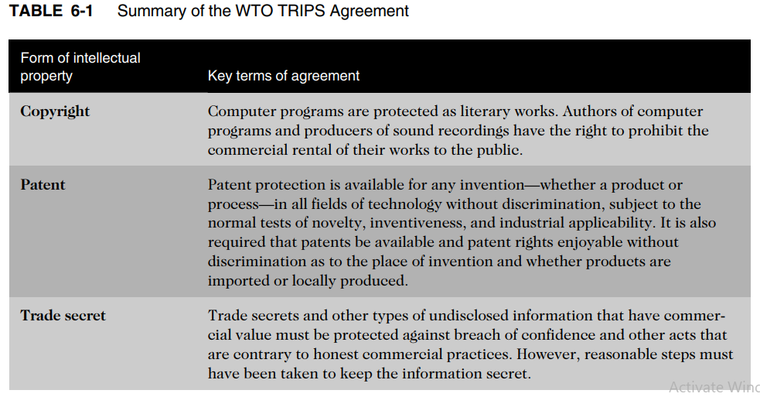
Copyrights (cont’d.)
Ethics in Information Technology, Fourth Edition
18
Notes:
18

Slide 19
Copyrights (cont’d.)
World Intellectual Property Organization (WIPO)
Agency of the United Nations
Advocates for the interests of intellectual property owners
WIPO Copyright Treaty provides additional copyright protections for electronic media
Ethics in Information Technology, Fourth Edition
19

Slide 20
Copyrights (cont’d.)
Digital Millennium Copyright Act (DMCA)
Implementation of WIPO treaty
Civil and criminal penalties included
Governs distribution of tools and software that can be used to circumvent technological measures used to protect copyrighted works
Provides safe harbors for ISPs whose customers/subscribers may be breaking copyright laws
ISP must comply with “notice and takedown procedures” that grant copyright holders a process to halt access to alleged infringing content
Ethics in Information Technology, Fourth Edition
20

Slide 21
Copyrights (cont’d.)
Digital Millennium Copyright Act (DMCA) - 1998
The DMCA added new provisions, making it an offense to do the following:
Circumvent a technical protection
Develop and provide tools that allow others to access a technologically protected work
Manufacture, import, provide, or traffic in tools that enable others to circumvent protection and copy a protected work
Example to follow
Ethics in Information Technology, Fourth Edition
21

Slide 22
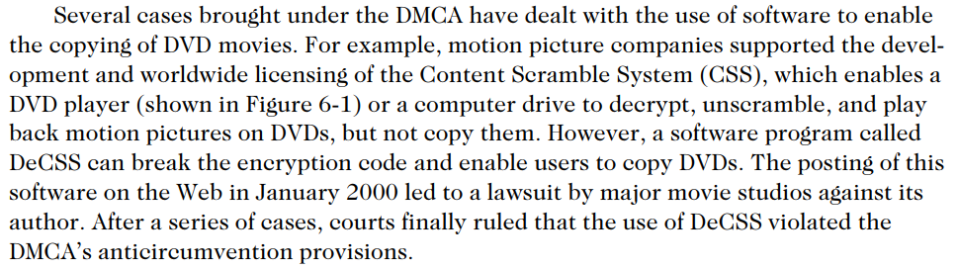
Copyrights (cont’d.)
Ethics in Information Technology, Fourth Edition
22

Slide 23
Copyrights (cont’d.)
Digital Millennium Copyright Act (DMCA)
Opponents of DMCA say that it gives holders of intellectual property so much power that it actually restricts the free flow of information.
For example, under DMCA, Internet service providers (ISPs) are required to remove access to Web sites that allegedly break copyright law—even before infringement has been proven.
Companies that provide Internet access to music and videos face legal action and the failure of their businesses if they do not gain approval to publish content from the music and movie industries.
Ethics in Information Technology, Fourth Edition
23

